Slide 1
GENETIC ALGORITHMS
Course Code: CSC4226
Course Title: Artificial Intelligence and Expert System
Dept. of Computer Science
Faculty of Science and Technology
Lecture No: | Five (5) | Week No: | Five (5) | Semester:
Lecturer: | Prof. Dr. Firoz Ahmed fahmed@aiub.edu

Slide 2
Lecture Outline
What are GA’s ?
Biological Background.
Basic Genetic Algorithm.
Encoding.
Operators of GA.
Example Problem.

Slide 3
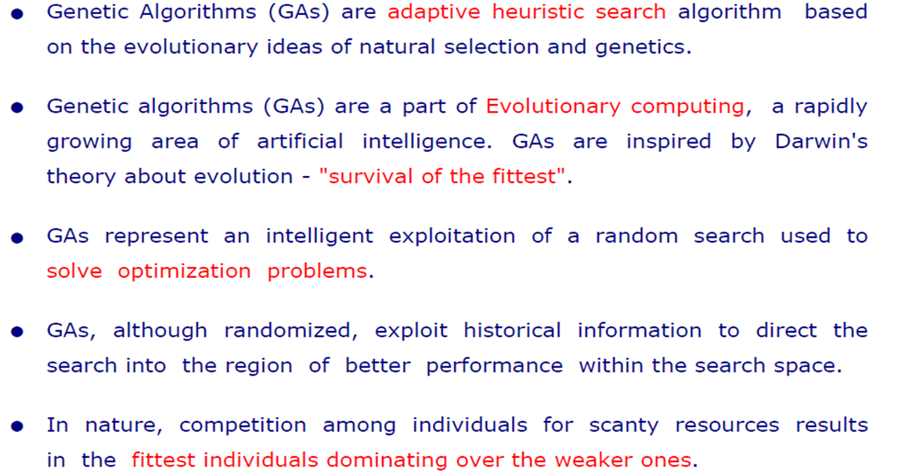
What are GAs?

Slide 4
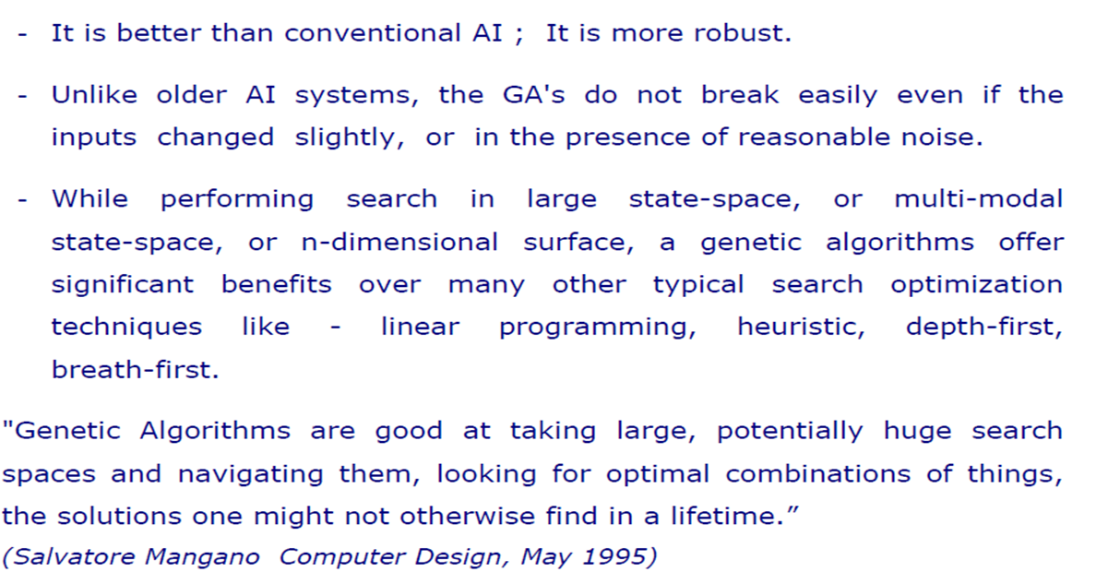
WHY GA?

Slide 5
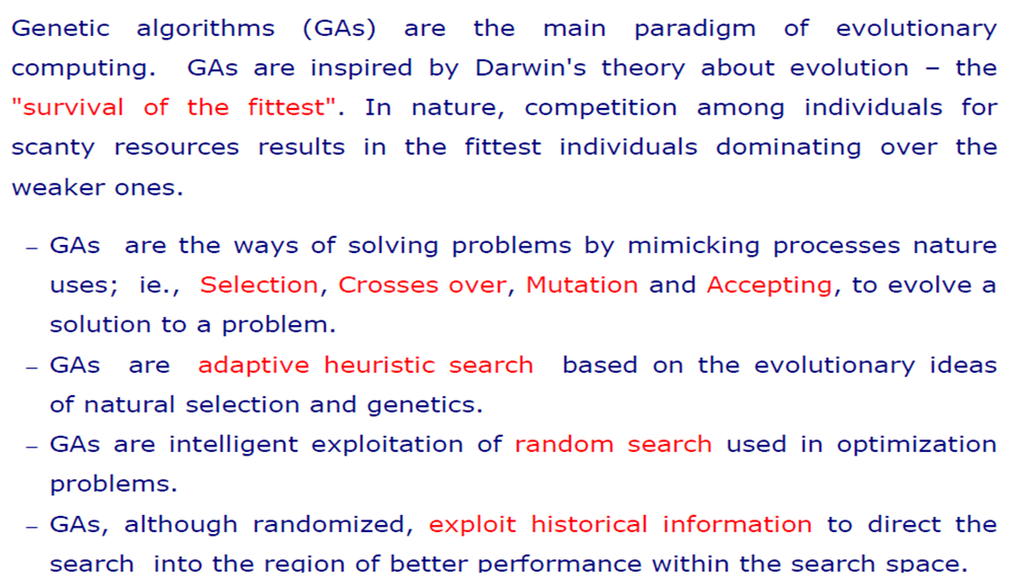
GA: BASIC CONCEPT

Slide 6
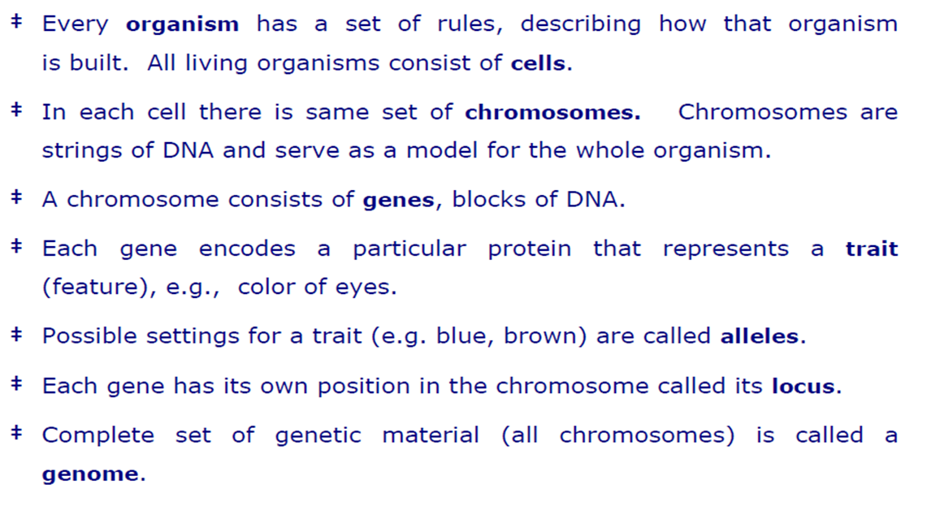
BIOLOGICAL BACKGROUND

Slide 7
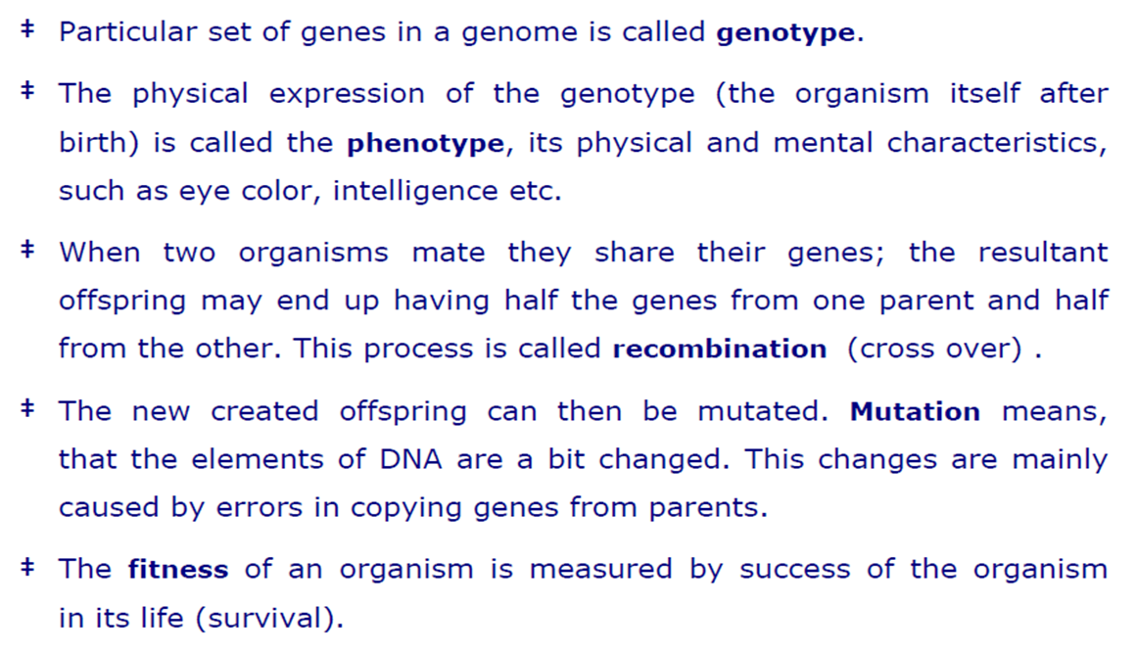
BIOLOGICAL BACKGROUND

Slide 8
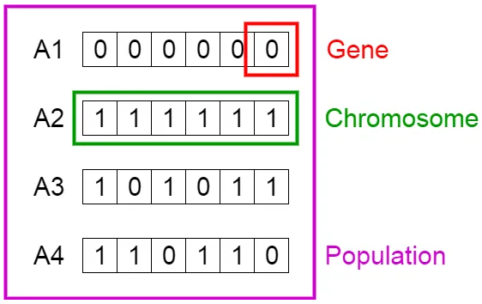
BIOLOGICAL BACKGROUND

Slide 9
BIOLOGICAL BACKGROUND
Population: Population is the subset of all possible or probable solutions, which can solve the given problem.
Chromosomes: A chromosome is one of the solutions in the population for the given problem, and the collection of gene generate a chromosome.
Gene: A chromosome is divided into a different gene, or it is an element of the chromosome.
Allele: Allele is the value provided to the gene within a particular chromosome.
Fitness Function: The fitness function is used to determine the individual's fitness level in the population. It means the ability of an individual to compete with other individuals. In every iteration, individuals are evaluated based on their fitness function.
Genetic Operators: In a genetic algorithm, the best individual mate to regenerate offspring better than parents. Here genetic operators play a role in changing the genetic composition of the next generation.
Selection

Slide 10
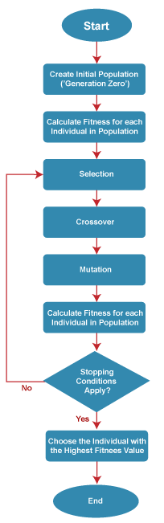
General Workflow of a Simple Genetic Algorithm

Slide 11
Initialization
The process of a genetic algorithm starts by generating the set of individuals, which is called population
Here each individual is the solution for the given problem
An individual contains or is characterized by a set of parameters called Genes
Genes are combined into a string and generate chromosomes, which is the solution to the problem
One of the most popular techniques for initialization is the use of random binary strings.

Slide 12
Fitness Assignment
Fitness function is used to determine how fit an individual is?
It means the ability of an individual to compete with other individuals
In every iteration, individuals are evaluated based on their fitness function
The fitness function provides a fitness score to each individual
This score further determines the probability of being selected for reproduction
The high the fitness score, the more chances of getting selected for reproduction.

Slide 13
Fitness Assignment
The idea is to give preference to the individuals with good fitness scores and allow them to pass their genes to successive generations.
The selection process determines which individuals from the population will be chosen as parents for reproduction based on their fitness (how well they solve the problem).
The selection phase involves the selection of individuals for the reproduction of offspring
All the selected individuals are then arranged in a pair of two to increase reproduction
Then these individuals transfer their genes to the next generation.
There are three types of Selection methods available, which are:
Roulette wheel selection
Tournament selection
Rank-based selection

Slide 14
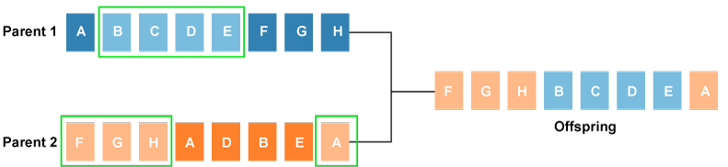
Crossover
After the selection process, the creation of a child occurs in the reproduction step
In this step, the genetic algorithm uses two variation operators that are applied to the parent population
The two operators involved in the reproduction phase are given below
Crossover: The crossover plays a most significant role in the reproduction phase of the genetic algorithm
In this process, a crossover point is selected at random within the genes
Then the crossover operator swaps genetic information of two parents from the current generation to produce a new individual representing the offspring.

Slide 15
Crossover
The genes of parents are exchanged among themselves until the crossover point is met
These newly generated offspring are added to the population
This process is also called or crossover
Types of crossover styles available
One point crossover
Two-point crossover
Livery crossover
Inheritable Algorithms crossover

Slide 16
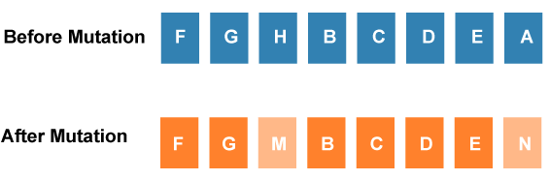
Mutation
The mutation operator inserts random genes in the offspring (new child) to maintain the diversity in the population
It can be done by flipping some bits in the chromosomes
Mutation helps in solving the issue of premature convergence and enhances diversification
The below image shows the mutation process:
Types of mutation styles available,
Flip bit mutation
Gaussian mutation
Exchange/Swap mutation

Slide 17
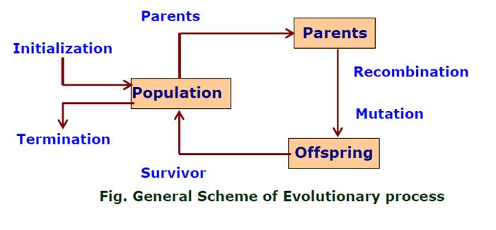
GA: FLOW-CHART

Slide 18
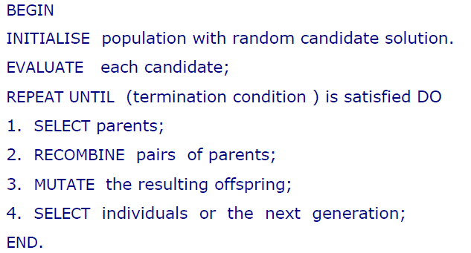
GA: PSEUDO-CODE

Slide 19
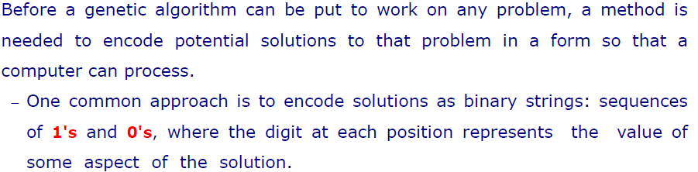
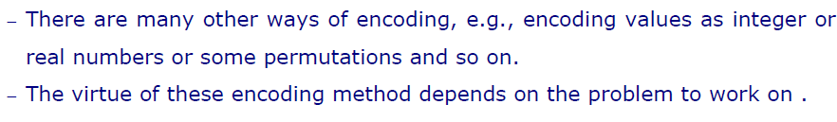
ENCODING

Slide 20
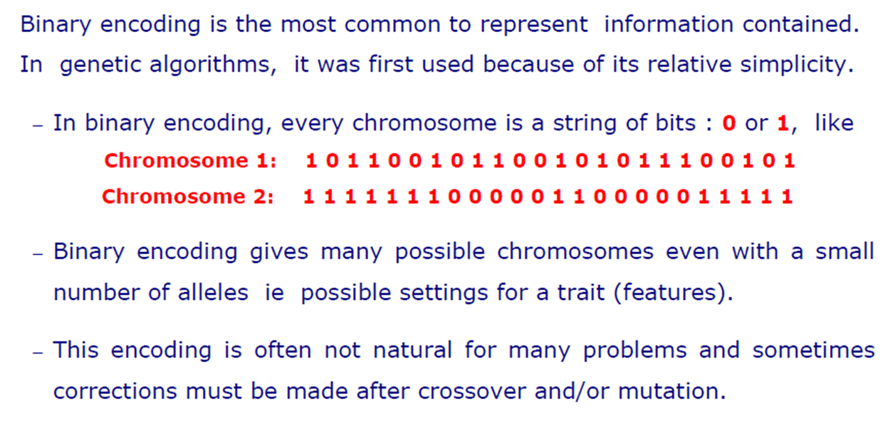
BINARY ENCODING

Slide 21
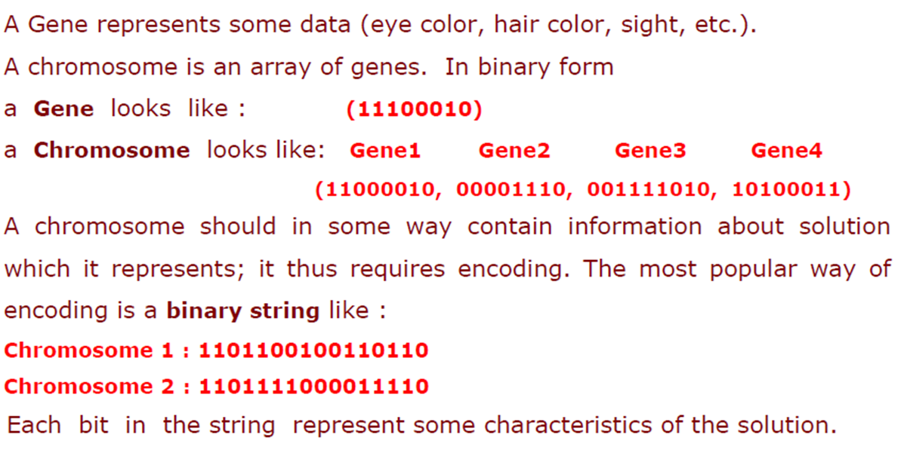
Example: Binary Encoding

Slide 22
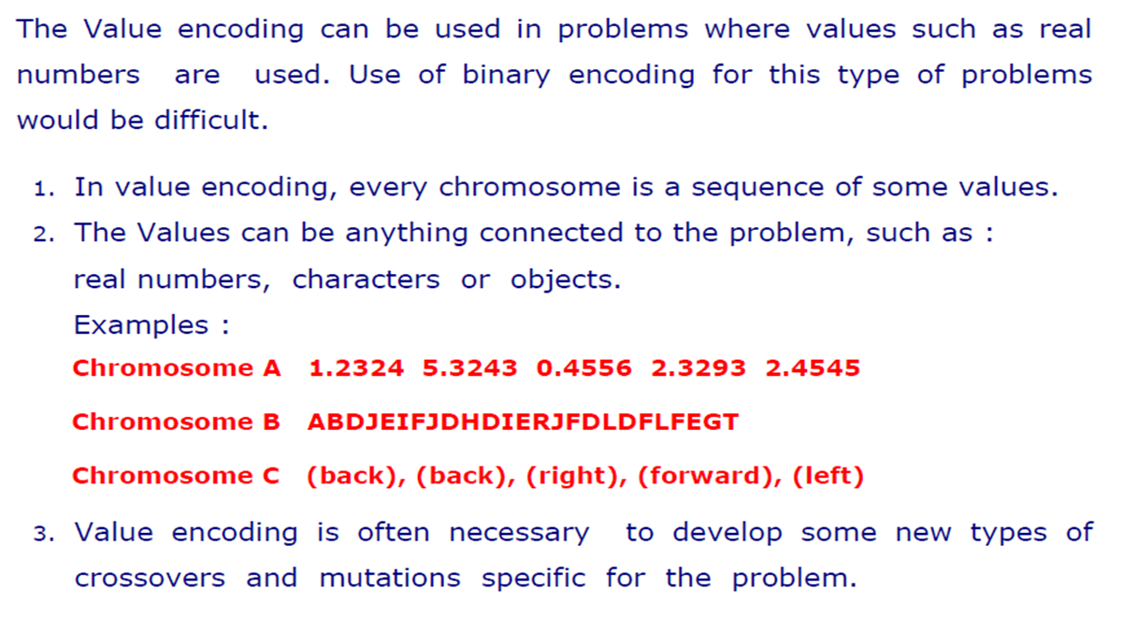
Value Encoding

Slide 23
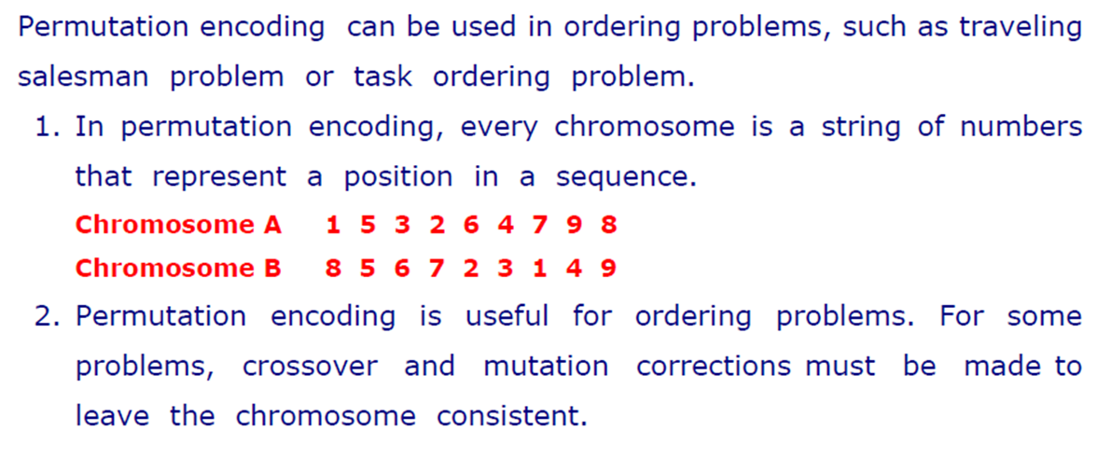
Permutation Encoding

Slide 24
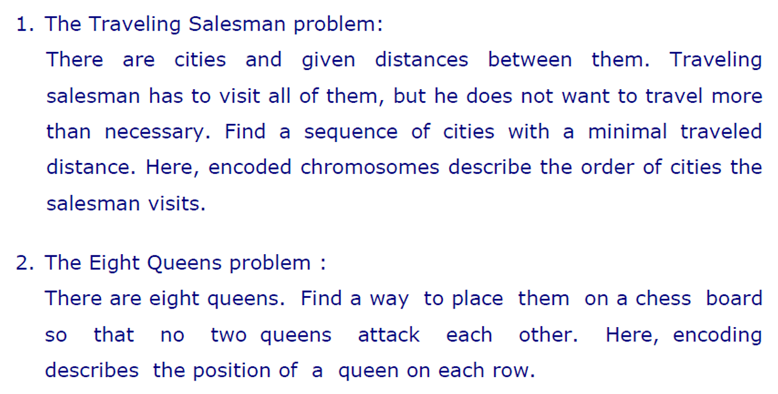
Examples: Permutation Encoding

Slide 25
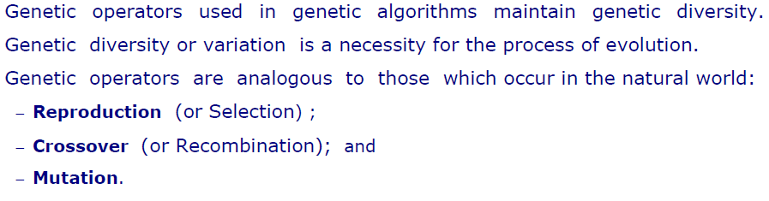
Operators of GA

Slide 26
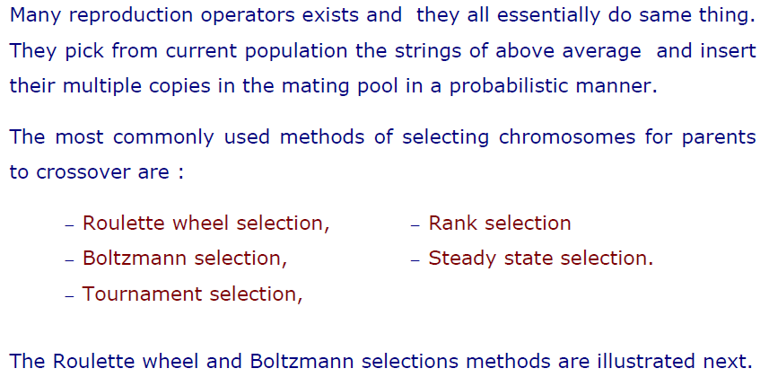
Selection

Slide 27
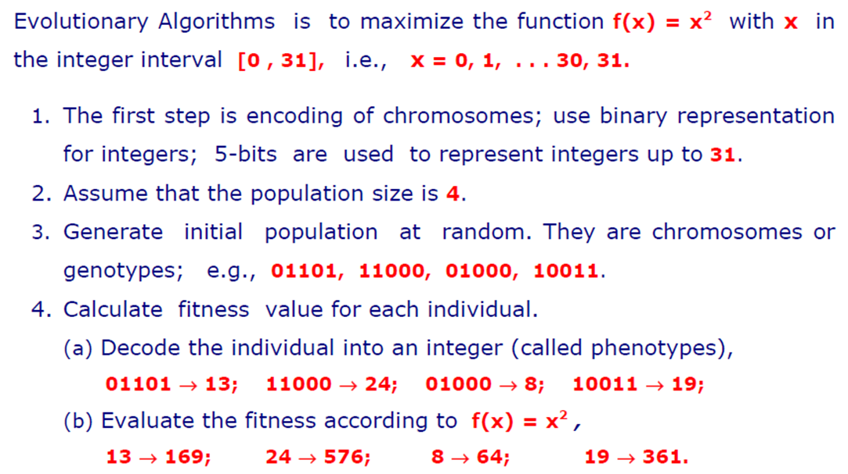
Example of Selection

Slide 28
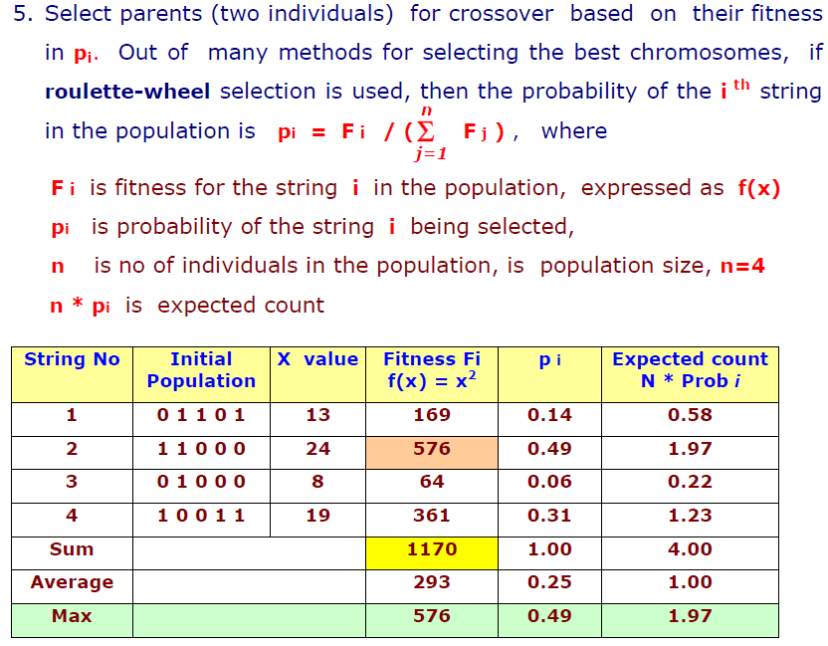
Example of Selection

Slide 29
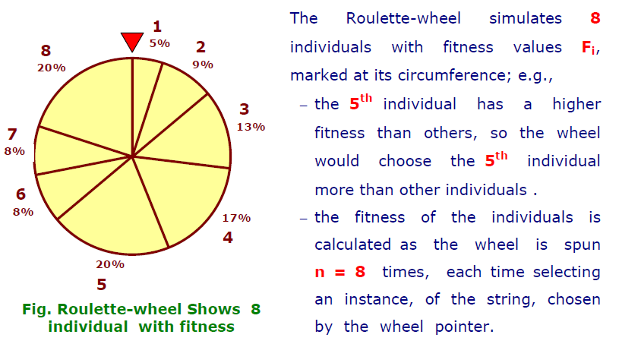
Roulette Wheel Selection

Slide 30
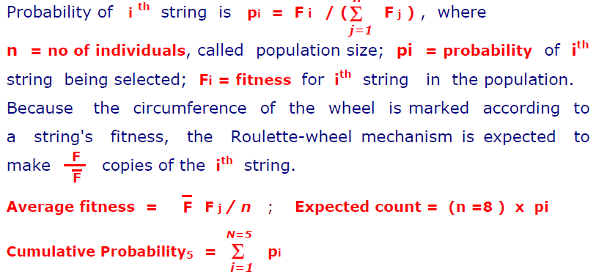
Roulette Wheel Selection

Slide 31
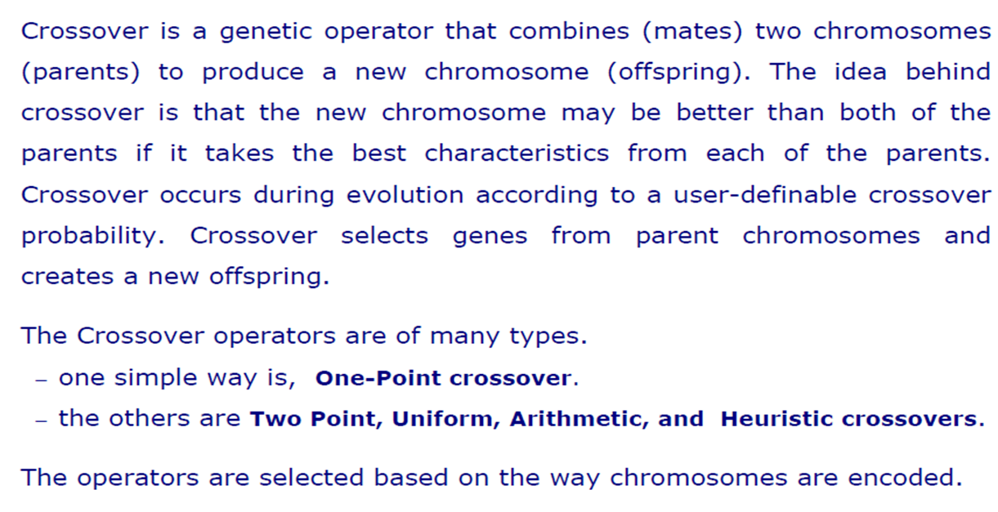
Crossover

Slide 32
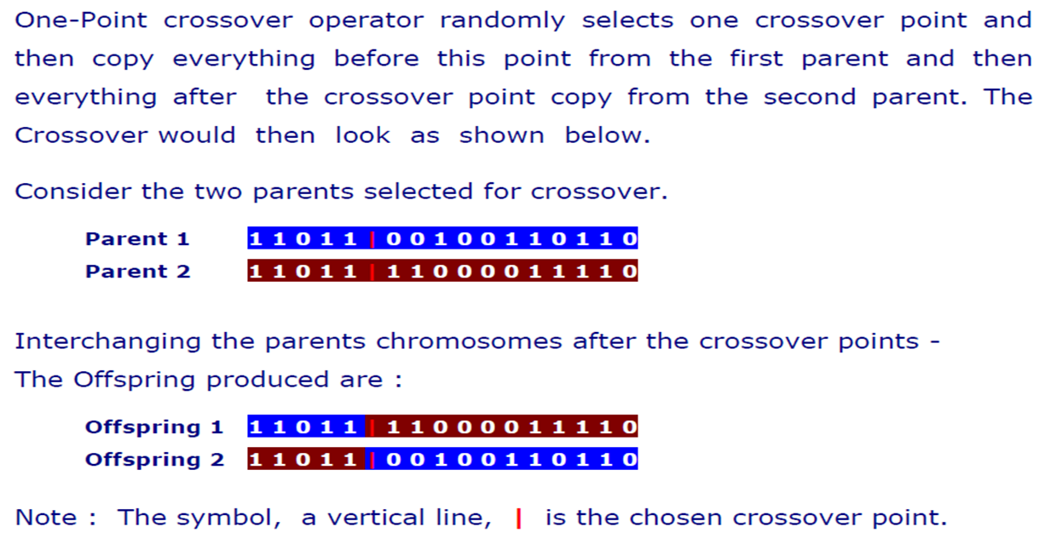
One-Point Crossover

Slide 33
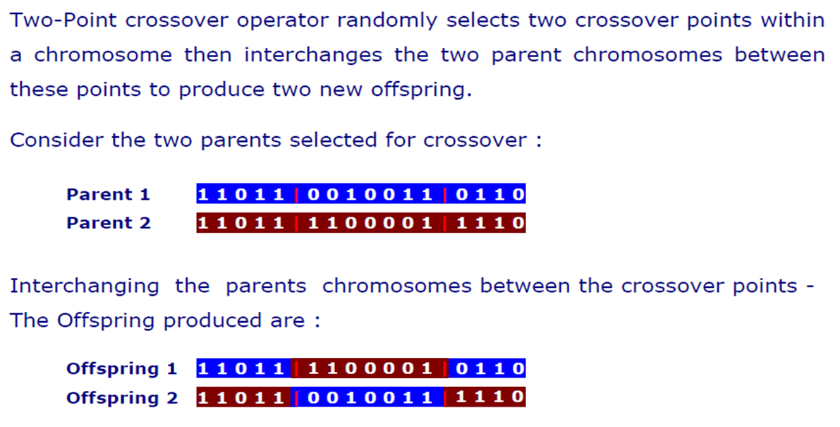
Two-Point Crossover

Slide 34
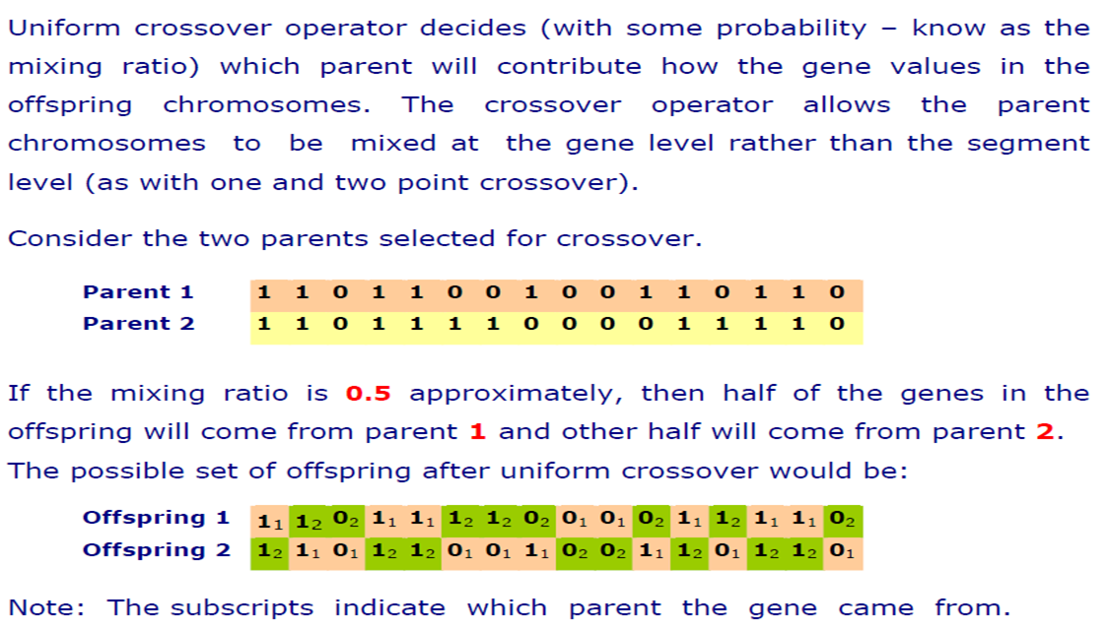
Uniform Crossover

Slide 35
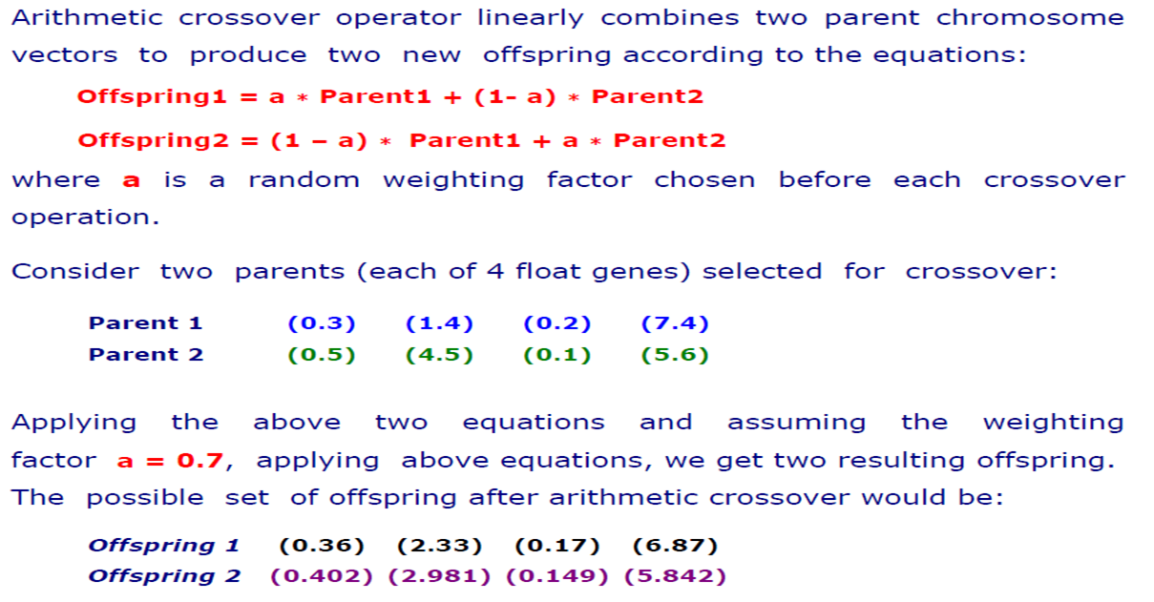
Arithmetic Crossover

Slide 36
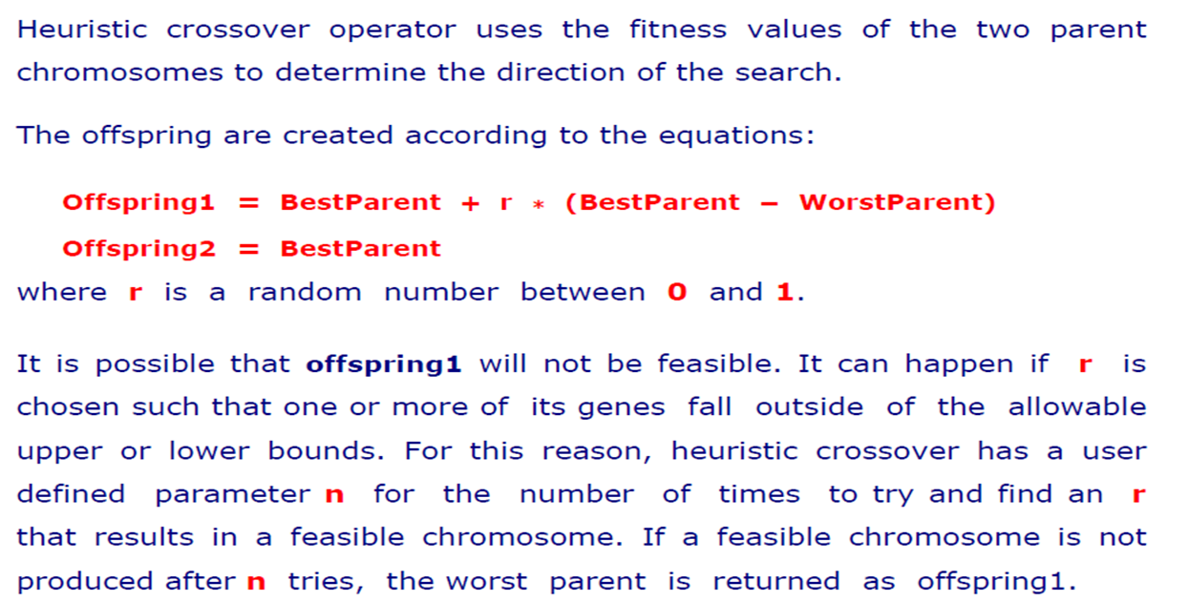
Heuristic Crossover

Slide 37
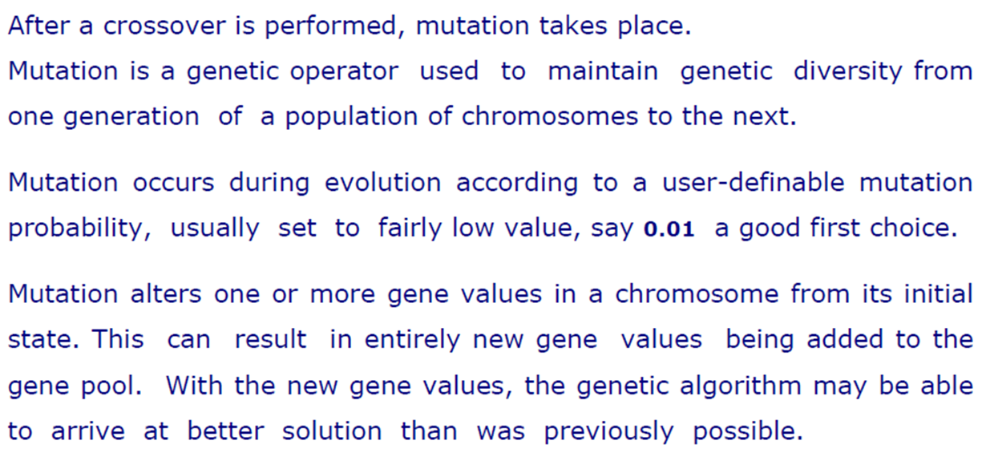
Mutation

Slide 38
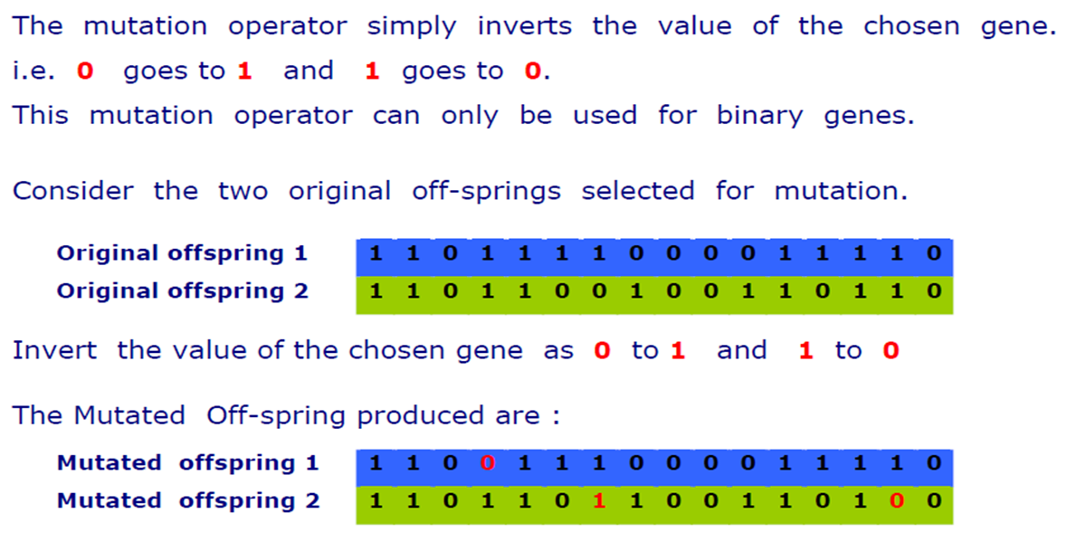
Flip Bit Mutation

Slide 39
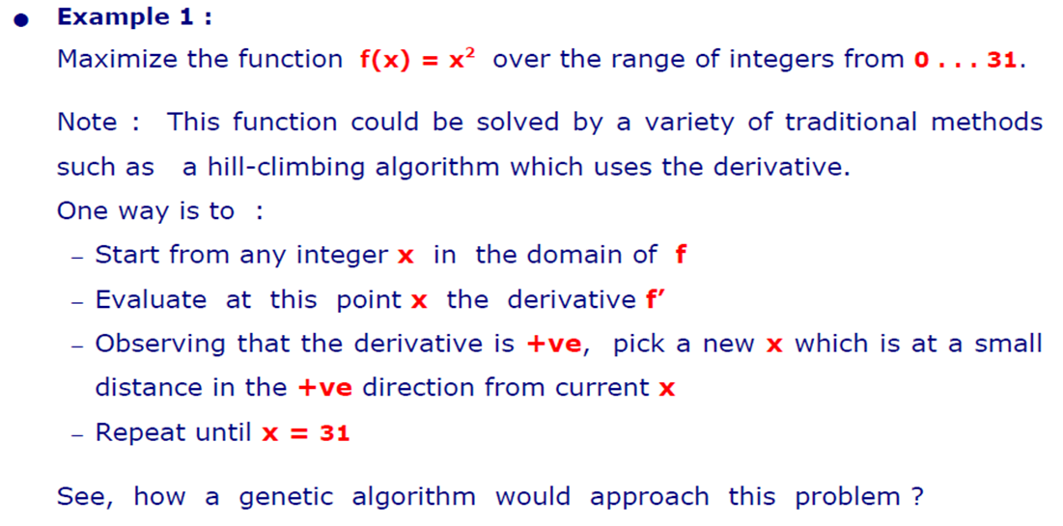
Demonstration

Slide 40
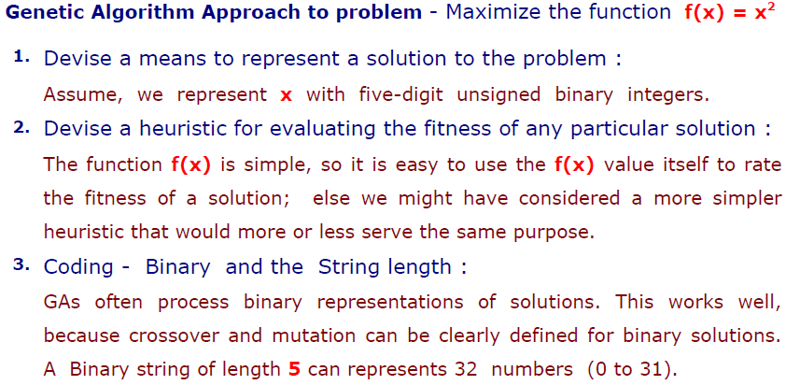
GA Approach

Slide 41
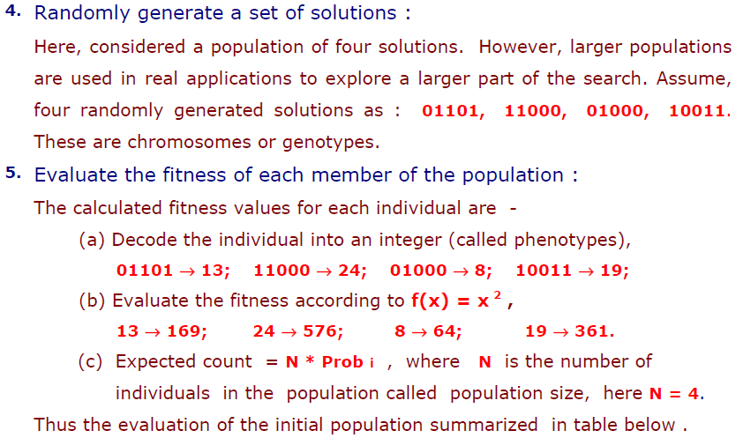
GA Approach

Slide 42
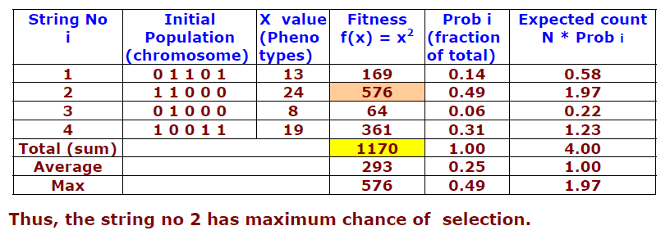
Calculating Fitness & Probability

Slide 43
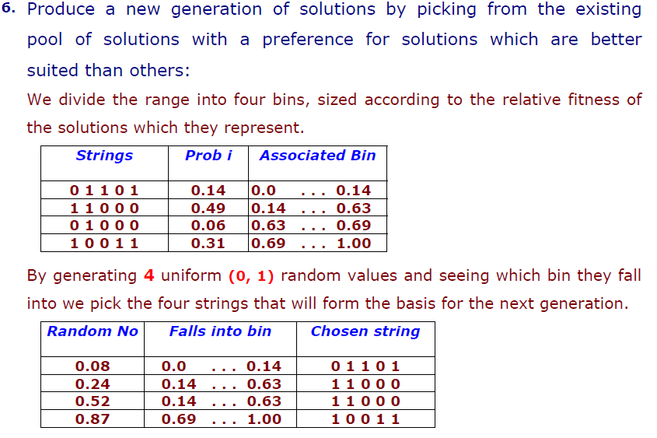
Selection

Slide 44
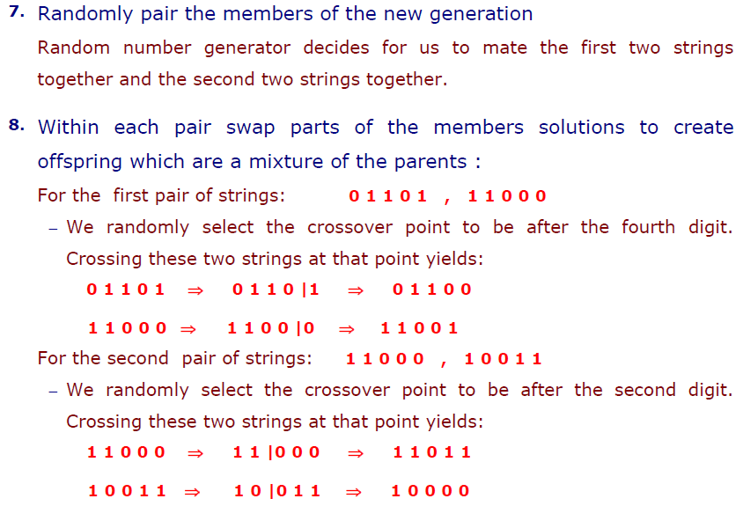
Crossover

Slide 45
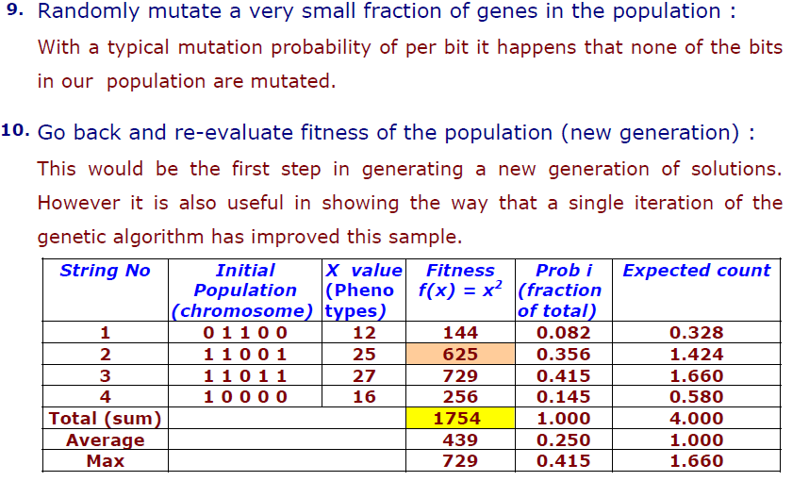
Mutate & Re-evaluate

Slide 46
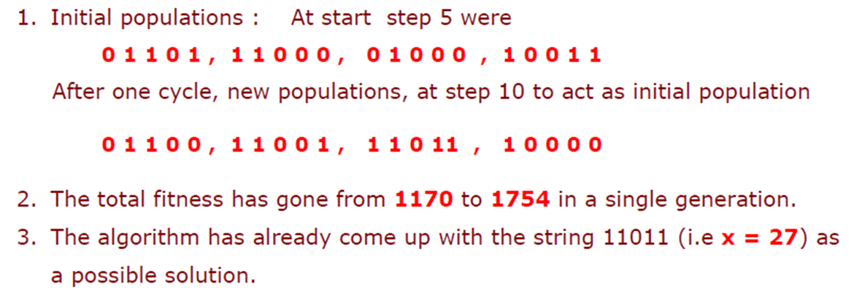
Improved: Individual & Total Fitness

Slide 47
References
“Practical Genetic Algorithms,” by Randy L. Haupt and Sue Ellen Haupt.

Slide 48
Books
“Artificial Intelligence: A Modern Approach,” by Stuart J. Russell and Peter Norvig.
"Artificial Intelligence: Structures and Strategies for Complex Problem Solving", by George F. Luger, (2002)
"Artificial Intelligence: Theory and Practice", by Thomas Dean.
"AI: A New Synthesis", by Nils J. Nilsson.
“Programming for machine learning,” by J. Ross Quinlan,
“Neural Computing Theory and Practice,” by Philip D. Wasserman, .
“Neural Network Design,” by Martin T. Hagan, Howard B. Demuth, Mark H. Beale, .
“Practical Genetic Algorithms,” by Randy L. Haupt and Sue Ellen Haupt.
“Genetic Algorithms in Search, optimization and Machine learning,” by David E. Goldberg.
"Computational Intelligence: A Logical Approach", by David Poole, Alan Mackworth, and Randy Goebel.
“Introduction to Turbo Prolog”, by Carl Townsend.

